Slide 1

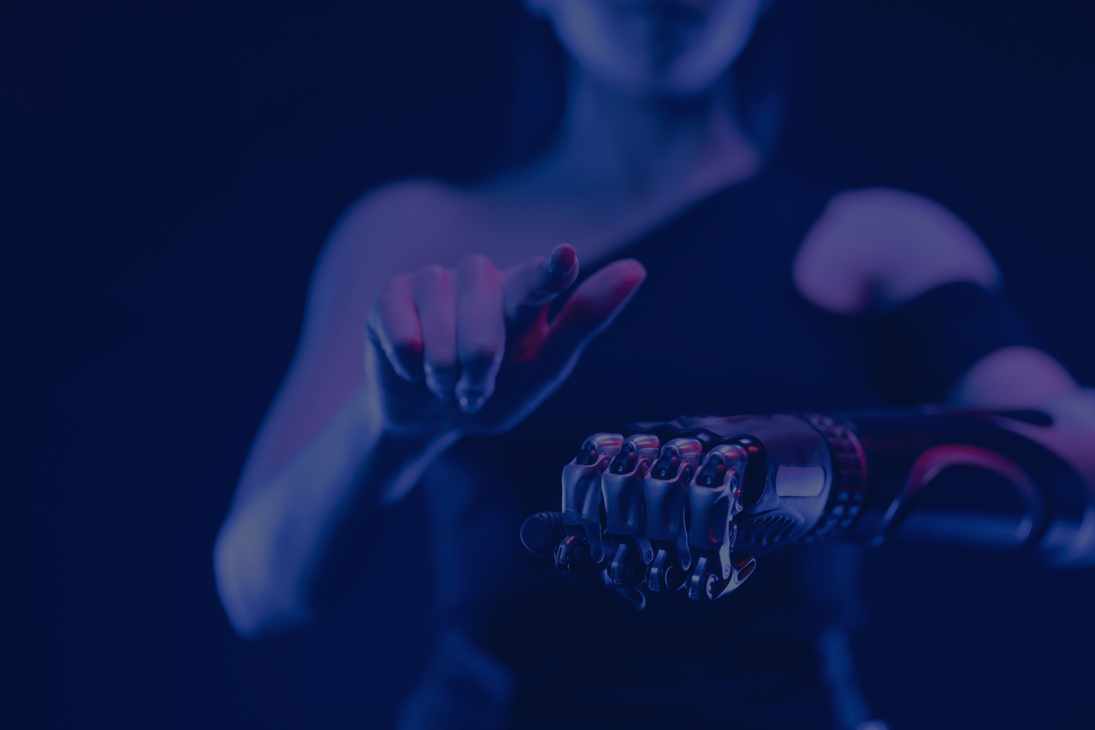

AI unlimited
Harnessing Generative AI
for Manufacturing Innovation：
Applications and Opportunities
M11209202 黃雅婄 Huang Ya Pei
Notes:
https://ieeexplore-ieee-org.ntust.idm.oclc.org/document/10463265

Slide 2



1
AI unlimited
Background
M11209202 Huang Ya Pei

Slide 3


We will talk about…
Challenges
Examples of AI applications
Conclusion
Advantages and Opportunities
AI unlimited
01
Background

Slide 4

Modern manufacturing faces issues
Cost-efficiency
Environmental sustainability
Climate concerns
AI unlimited
02
Background

Slide 5
2
AI unlimited
Advantages
and
Opportunities
M11209202 Huang Ya Pei
Notes:
Alright, now let’s dive into the literature review part.

Slide 6
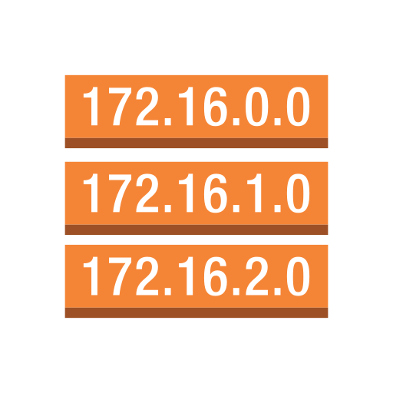

Key points of benefit when applying GAI…
Reduce Costs and Boost Efficiency
->Making enterprises more competitive
Analyze Data Quickly and Predict Accurately
Optimize Design and Production Processes
Enhancing Customization Capabilities
AI unlimited
Nirmala UI
Nirmala UI
01
Advantage

Slide 7
AI unlimited
Generative AI
Cost-efficiency
Environmental sustainability
Climate concerns
Examples of AI applications
Generative AI is changing the manufacturing industry
the advantages and opportunities by GAI in the manufacturing industry, as well as the challenges we might face.
Nirmala UI
Nirmala UI
03
Background
Notes:
Generative Artificial Intelligence, or GenAI, is revolutionizing the manufacturing industry. GenAI is a class of artificial intelligence that can create new content, such as text, images, or sounds, by learning patterns from existing data. It's a breakthrough in computational intelligence, consisting of algorithms that generate new data patterns identical to accurate data.
生成式人工智能，或稱GenAI，如何革新製造業。GenAI是一種人工智能技術，能夠通過學習現有數據模式生成新的內容，如文本、圖像或聲音。這是一個計算智能的突破，包含能生成與真實數據模式相同的新數據的算法

Slide 8
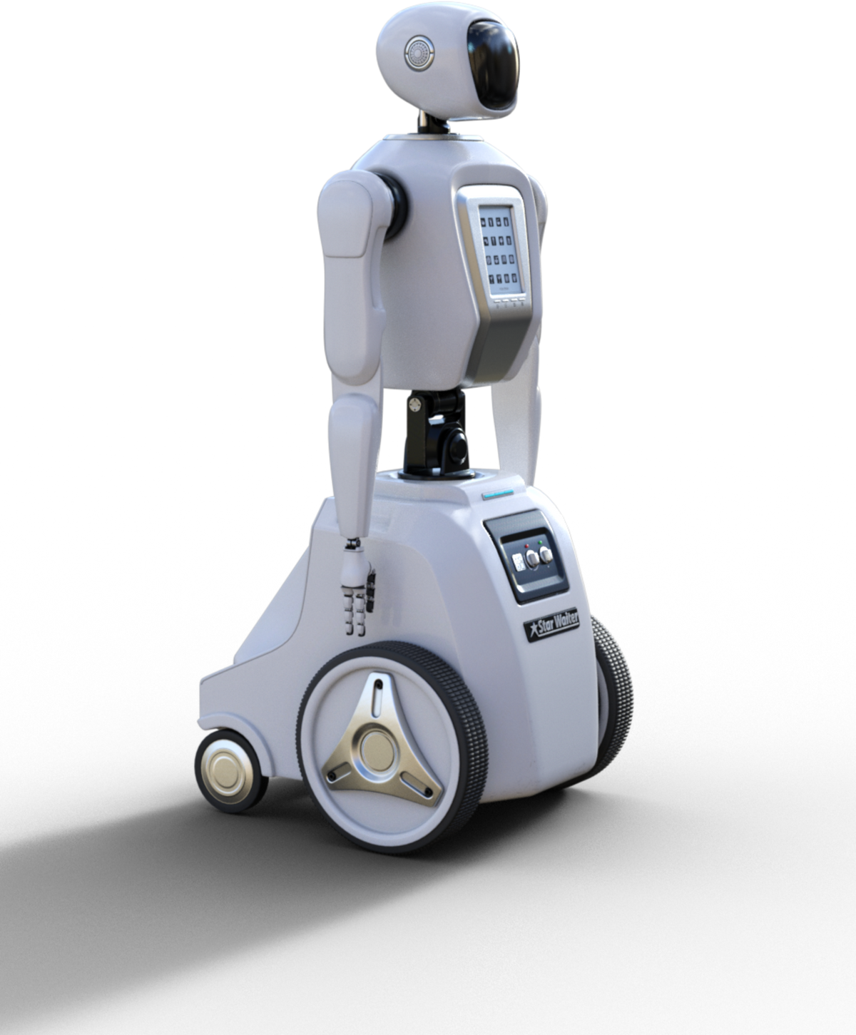
AI unlimited
1. Evolution of Manufacturing
Key part of modern economies
Changed significantly over centuries
Driven by various industrial revolutions
Generative AI
05
Introduction
Notes:
Manufacturing is is a key part of modern economies and has changed a lot over the centuries due to various industrial revolutions.
Each industrial revolution brought technological, societal, and economic breakthroughs, from the steam engine to mass production, and now to digital transformation. Each revolution has reshaped how we produce goods and manage resources.製造業是現代經濟的基石，幾個世紀以來取得了顯著的發展。每一次工業革命都帶來了技術、社會和經濟的突破，從蒸汽機到大規模生產，再到現在的數位轉型。每一次革命都重塑了我們生產商品和管理資源的方式。

Slide 9
AI unlimited
2. The Fourth Industrial Revolution
AI
Big Data
Internet of Things (IoT)
Generative AI
06
Introduction
Notes:
Currently, we are in the midst of the Fourth Industrial Revolution, characterized by the integration of digital technologies. Key technologies include Artificial Intelligence (AI), Big Data, and the Internet of Things (IoT). One of the most exciting developments in this space is Generative AI.
Companies like Facebook, Google, Anthropic, and OpenAI have created Large Language Models (LLMs), such as OpenAI's GPT-3 and Google's BARD.
These models have demonstrated incredible abilities to understand and generate human-like language, inspiring advancements across various industries, including manufacturing.目前，我們正處於以數位科技融合為特徵的第四次工業革命之中。關鍵技術包括人工智慧（AI）、大數據和物聯網（IoT）。該領域最令人興奮的發展之一是產生人工智慧。 Facebook、Google、Anthropic 和 OpenAI 等公司已經創建了大型語言模型 (LLM)，例如 OpenAI 的 GPT-3 和 Google 的 BARD。這些模型展現了令人難以置信的理解和產生類人語言的能力，激發了包括製造業在內的各個行業的進步。

Slide 10
AI unlimited
3. Drivers of Change
Cost-efficiency
Environmental sustainability
Climate concerns
Generative AI
07
Introduction
Notes:
Several factors are driving changes in the manufacturing industry today, including the need for cost-efficiency, environmental sustainability, and responses to climate concerns. GenAI plays a crucial role in meeting these demands by offering unprecedented levels of efficiency, customization, and quality improvement. It can develop new materials and configurations from existing data, pushing the boundaries of what’s possible in manufacturing.
有幾個因素正在推動當今製造業的變革，包括對成本效率、環境永續性和應對氣候問題的需求。 GenAI 透過提供前所未有的效率、客製化和品質改進水平，在滿足這些需求方面發揮著至關重要的作用。它可以根據現有數據開發新材料和配置，突破製造業的極限。

Slide 11
AI unlimited
4. Impact on the Industry
Changes in labor dynamics
New production methods
Transformation of global supply chains
Generative AI
08
Introduction
Notes:
The impact of these changes on the manufacturing industry is profound. We are seeing shifts in labor dynamics, with a greater emphasis on digital skills and automation. Production methods are becoming more advanced, allowing for higher precision and flexibility.
Additionally, global supply chains are transforming to become more resilient and responsive. Despite challenges like skill gaps, high investment costs, and cybersecurity concerns, the adoption of GenAI promises a new era of innovation and global competitiveness for the manufacturing sector.這些變化對製造業的影響是深遠的。我們看到勞動力動態的變化，更加強調數位技能和自動化。生產方法變得更加先進，實現了更高的精度和靈活性。此外，全球供應鏈正在轉型，變得更具彈性和反應能力。儘管存在技能差距、高投資成本和網路安全問題等挑戰，但 GenAI 的採用將為製造業帶來創新和全球競爭力的新時代。

Slide 12
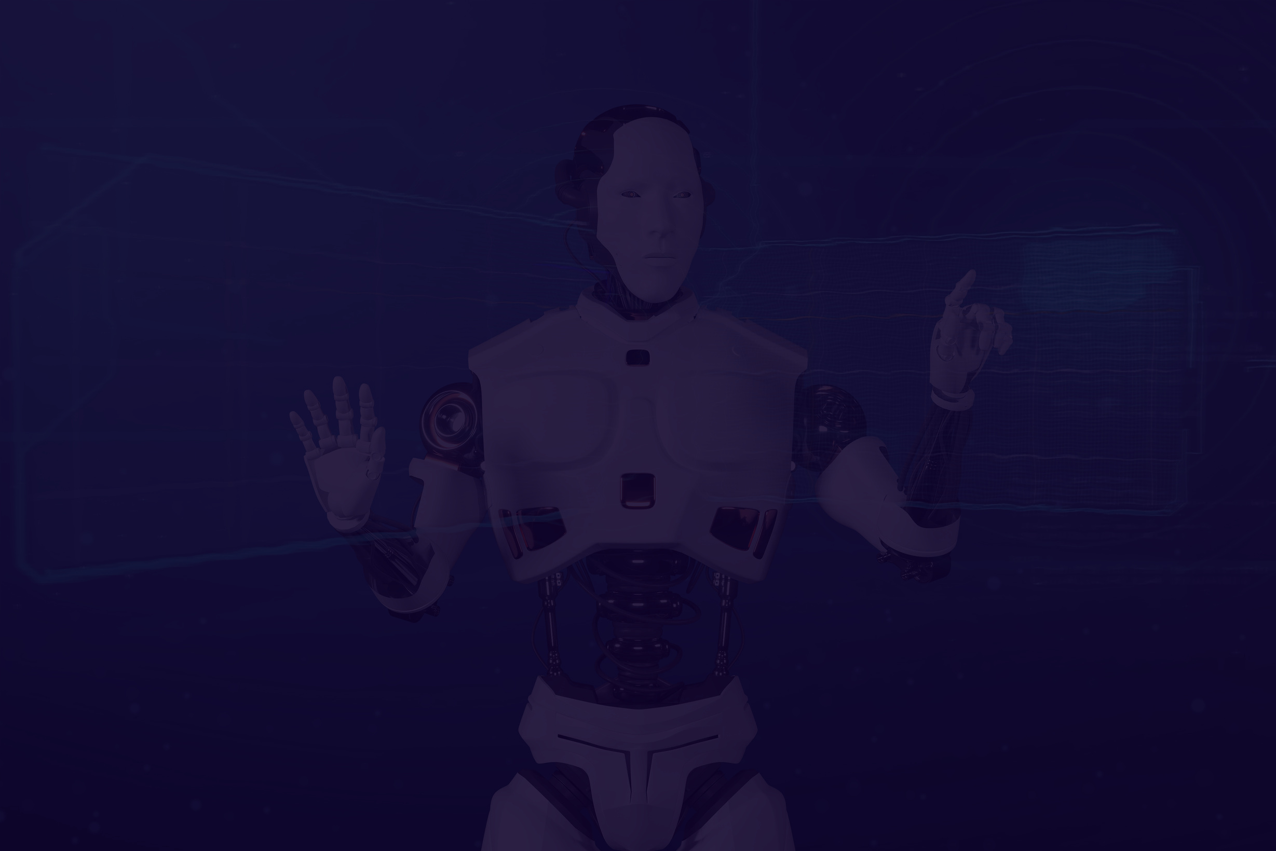
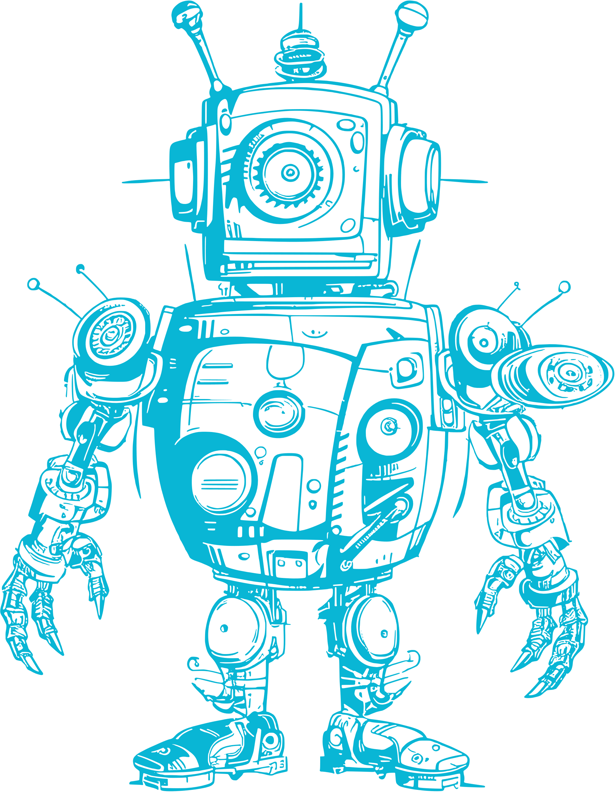

R
10
AI unlimited
A
Role of Ai in Modern Manufacturing
Shift from traditional to automated
AI’s analytical and predictive capabilities
Enhanced customization in manufacturing
Challenges
workforce training needs
high integration costs
Literature Review
Literature Review
Notes:
Let's talk about the role of AI in modern manufacturing. According to previous study, AI has been foundational in evolving manufacturing processes. We've seen a shift from traditional methods to more automated and data-driven approaches. This change is largely due to AI's powerful analytical and predictive abilities, which are essential for Generative AI applications. AI can generate innovative designs by analyzing vast amounts of data and recognizing advanced patterns. This capability leads to greater customization in manufacturing, setting the stage for what GenAI can achieve with new, data-informed designs. However, the study also points out some challenges, like the need for workforce training and the high costs associated with integrating AI. These factors are important when considering the adoption of advanced AI technologies like GenAI. Overall, its helps us understand AI's transformative impact on manufacturing and prepares us to explore the specific applications and opportunities of Generative AI.我們來談談人工智慧在現代製造中的作用。根據一項重要研究，人工智慧一直是不斷發展的製造流程的基礎。我們已經看到從傳統方法到更自動化和數據驅動的方法的轉變。這種變化很大程度上歸功於人工智慧強大的分析和預測能力，這對於生成式人工智慧應用至關重要。人工智慧可以透過分析大量數據和識別高級模式來產生創新設計。這種能力可以實現更大程度的製造客製化，為 GenAI 透過新的、基於數據的設計實現目標奠定了基礎。然而，該研究也指出了一些挑戰，例如勞動力培訓的需求以及與人工智慧整合相關的高成本。在考慮採用 GenAI 等先進人工智慧技術時，這些因素非常重要。總的來說，這項研究幫助我們了解人工智慧對製造業的變革性影響，並為我們探索生成式人工智慧的具體應用和機會做好準備。
Shift from traditional to automated
AI’s analytical and predictive capabilities
Enhanced customization in manufacturing
Challenges
workforce training needs
high integration costs

Slide 13
R
11
AI unlimited
B
Genai in Additive Manufacturing
Synergy between human expertise and Generative AI
Enhances design and manufacturing agility
Generative design (GD)
as a key GenAI application
Enhances, not replaces, human capabilities
Literature Review
Literature Review
Notes:
Now, let's dive into how Generative AI is transforming additive manufacturing. Bendoly and his colleagues examine the powerful combination of human expertise and Generative AI in this field. Their research highlights how GenAI, especially through generative design, plays a crucial role in making design and manufacturing more agile. Generative design allows companies to quickly adjust their manufacturing strategies, creating an environment ripe for innovation and responsiveness. This is particularly important given today's fast-changing market demands and global uncertainties. The study also emphasizes that GenAI enhances human capabilities rather than replacing them. It shows how GenAI acts as a collaborative tool, boosting human creativity and decision-making with its computational strength. The research provides real-world examples of how GenAI helps make rapid design changes and promotes a culture of continuous learning and adaptation within organizations.現在，讓我們深入探討生成式人工智慧如何改變積層製造。 Bendoly 和他的同事研究了該領域人類專業知識和生成人工智慧的強大結合。他們的研究強調了 GenAI（尤其是透過生成設計）如何在使設計和製造更加敏捷方面發揮關鍵作用。衍生式設計使公司能夠快速調整其製造策略，創造一個適合創新和響應能力的環境。考慮到當今快速變化的市場需求和全球不確定性，這一點尤其重要。該研究還強調 GenAI 增強了人類的能力，而不是取代它們。它展示了 GenAI 如何作為協作工具，利用其運算能力來提高人類創造力和決策能力。研究提供了真實世界的例子，說明 GenAI 如何幫助快速進行設計變更並促進組織內持續學習和適應的文化。
Synergy between human expertise and Generative AI
Enhances design and manufacturing agility
Generative design (GD)
as a key GenAI application
Enhances, not replaces, human capabilities

Slide 14
R
12
AI unlimited
Genai's Application in Design and Production
C
Using machine learning and neural networks
Generates images, text, and designs
Develops innovative prototypes
Learns from large datasets
Vital for innovation and customization
Enhances efficiency
Improves accuracy
Literature Review
Literature Review
Notes:
Now let's discuss Generative AI's role in design and production. Fezari and his team show how GenAI can transform manufacturing by creating new and original content using machine learning and neural networks. This technology is vital for innovation and customization. GenAI can generate images, text, and designs, which helps develop innovative prototypes. It can learn from large datasets to create new product designs or improve existing ones. GenAI also enhances efficiency by automating repetitive tasks and improving accuracy. This boosts production and personalization. The paper also highlights the need to address potential biases in data and ensure transparency in AI decisions, which are crucial for ethical AI integration in manufacturing.
現在讓我們來討論生成式人工智慧在設計和生產中的作用。 Fezari 和他的團隊展示了 GenAI 如何透過使用機器學習和神經網路創建新的原創內容來改變製造業。這項技術對於創新和客製化至關重要。 GenAI 可以產生圖像、文字和設計，這有助於開發創新原型。它可以從大型資料集中學習，以創建新的產品設計或改進現有的產品設計。 GenAI 還透過自動化重複任務和提高準確性來提高效率。這促進了生產和個性化。該論文還強調需要解決數據中的潛在偏差並確保人工智慧決策的透明度，這對於製造業中道德的人工智慧整合至關重要。
Using machine learning and neural networks
Generates images, text, and designs
Develops innovative prototypes
Learns from large datasets
Vital for innovation and customization
Enhances efficiency / Improves accuracy

Slide 15
R
13
AI unlimited
D
Genai in Product Development
Use real-time data and virtual simulations
Optimize design processes
Mirror physical products for iterative, data-driven design
Enhance product design, manufacturing, and lifecycle management
better data analytics, improved simulation technologies
Literature Review
Literature Review
Notes:
Let's talk about GenAI in product development. Tao and his team introduce the concept of digital twins, which use real-time data and virtual simulations to optimize design processes. Digital twins can mirror physical products, allowing for iterative and data-driven design. This concept aligns with GenAI's ability to create optimized solutions from complex data. The paper highlights how digital twins enhance product design, manufacturing, and lifecycle management. It also discusses challenges like data integration and real-time synchronization, similar to those faced with GenAI. Solutions include better data analytics and improved simulation technologies
我們來談談GenAI在產品開發上的應用。陶和他的團隊引入了數位孿生的概念，它使用即時數據和虛擬模擬來優化設計流程。數位孿生可以鏡像實體產品，從而實現迭代和數據驅動的設計。這個概念與 GenAI 從複雜資料創建優化解決方案的能力一致。該論文重點介紹了數位孿生如何增強產品設計、製造和生命週期管理。它還討論了數據整合和即時同步等挑戰，類似於 GenAI 面臨的挑戰。解決方案包括更好的數據分析和改進的模擬技術
Use real-time data and virtual simulations
Optimize design processes
Mirror physical products for iterative, data-driven design
Enhance product design, manufacturing, and lifecycle management
better data analytics, improved simulation technologies

Slide 16
R
14
AI unlimited
E
Role of Multidisciplinary Teams
Process optimization and predictive maintenance
Importance of diverse teams:
AI specialists, Industrial engineers, Production managers
Improve efficiency, reduce downtime,
enhance product quality
Address ethical considerations and data security
Literature Review
Literature Review
Notes:
The article by Rane highlights the critical role of multidisciplinary collaboration in integrating Generative AI, like ChatGPT, into manufacturing. It shows how GenAI can revolutionize various aspects, from process optimization to predictive maintenance, through effective teamwork. The article emphasizes the need for diverse teams, including AI specialists, industrial engineers, and production managers. These teams are essential for customizing GenAI solutions to meet specific manufacturing needs, which boosts operational efficiency, reduces downtime, and improves product quality. Rane also addresses the ethical and practical considerations of using GenAI in manufacturing. This includes the importance of ethical deployment, data security, and managing workforce dynamics. By taking a holistic approach, we can ensure the balanced integration of GenAI, achieving both technological advancement and ethical responsibility. Rane 的文章強調了多學科協作在將 ChatGPT 等生成式 AI 整合到製造業中的關鍵作用。它展示了 GenAI 如何透過有效的團隊合作徹底改變從流程優化到預測性維護的各個方面。文章強調了對多元化團隊的需求，包括人工智慧專家、工業工程師和生產經理。這些團隊對於客製化 GenAI 解決方案以滿足特定的製造需求至關重要，從而提高營運效率、減少停機時間並提高產品品質。 Rane 也闡述了在製造中使用 GenAI 的道德和實際考慮因素。這包括道德部署、資料安全和管理勞動力動態的重要性。透過採取整體方法，我們可以確保 GenAI 的平衡整合，實現技術進步和道德責任。
Process optimization and predictive maintenance
Importance of diverse teams:
AI specialists, Industrial engineers, Production managers
Improve efficiency, reduce downtime,
enhance product quality
Address ethical considerations and data security

Slide 17
3
AI unlimited
Discussion
M11209202 Huang Ya Pei
Notes:
By integrating GenAI, the manufacturing sector is transforming towards more significant innovation, efficiency, and sustainability. The following sections detail these transformative applications, underscoring GenAI's critical influence in shaping the future of manufacturing.透過整合 GenAI，製造業正在向更顯著的創新、效率和永續性轉型。以下部分詳細介紹了這些變革性應用，強調了 GenAI 在塑造製造業未來方面的關鍵影響。

Slide 18
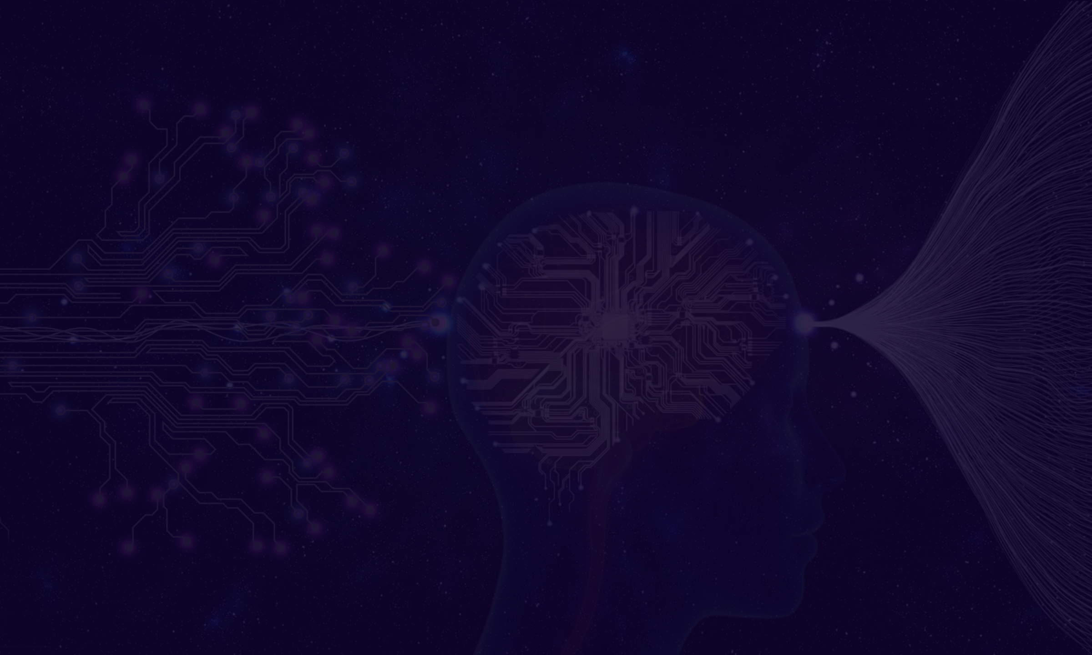

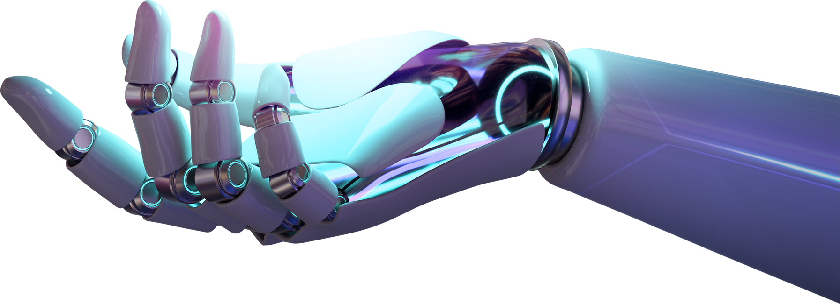
16
AI unlimited
Enhancing Efficient Contract Management
A
Automate and Analyze Contracts
Identifies key terms and potential risks
Ensure Compliance
Reduces legal vulnerabilities
Crucial for Complex Industries
Handles relationships with many stakeholders
Discussion
Notes:
GenAI, can make contract management more efficient. GenAI tools can scan and analyze contracts, picking out key terms and spotting potential risks. This helps ensure everything is compliant and reduces legal issues. This is really important in industries with complex business relationships and many stakeholders.
GenAI，可以讓合約管理更有效率。 GenAI 工具可以掃描和分析合同，挑選關鍵條款並發現潛在風險。這有助於確保一切合規並減少法律問題。這對於業務關係複雜且利害關係人眾多的行業來說非常重要
Automate and Analyze Contracts
Identifies key terms and potential risks
Ensure Compliance
Reduces legal vulnerabilities
Crucial for Complex Industries
Handles relationships with many stakeholders

Slide 19
17
AI unlimited
Transforming Supply Chain Operations
B
Predict and Manage Disruptions
Maintains steady operations despite unforeseen events
Act as a Control Tower
Assesses risks and proactively handles disruptions
Streamline Vendor Interactions
Provides quick solutions to sourcing challenges
Discussion
Notes:
Next, then about transform supply chain operations. GenAI can predict and manage disruptions, keeping things running smoothly even when unexpected events happen. It acts like a control tower, spotting risks and handling issues before they become big problems. Plus, GenAI can make vendor interactions easier and solve sourcing challenges quickly, making supply chain operations more efficient and resilient.
接下來，我們來討論 GenAI 如何改變供應鏈營運。 GenAI 可以預測和管理中斷，即使發生意外事件也能保持事物順利運作。它就像一個控制塔，發現風險並在問題變成大問題之前進行處理。此外，GenAI 可以使供應商互動變得更容易，並快速解決採購挑戰，使供應鏈營運更加高效和有彈性。
Predict and Manage Disruptions
Maintains steady operations despite unforeseen events
Act as a Control Tower
Assesses risks and proactively handles disruptions
Streamline Vendor Interactions
Provides quick solutions to sourcing challenges

Slide 20
AI unlimited
Production and Operational Efficiency
C
Predictive Maintenance
Reduces downtime and extends machinery life
Real-Time Monitoring
Identifies bottlenecks and suggests improvements
Dynamic Operational Manuals
Provides updated guidance and adapts to changes quickly
03
Discussion
Notes:
When we need to optimize production and operational efficiency. GenAI can analyze huge amounts of data from manufacturing processes to predict when maintenance is needed, reducing downtime and extending machinery life. It monitors production lines in real time, spots bottlenecks, and suggests improvements, boosting efficiency. Plus, GenAI can create dynamic, updated operational manuals, giving operators the best practices and helping them adapt quickly to changes.
我們來談談GenAI如何優化生產和營運效率。 GenAI 可以分析製造過程中的大量數據，以預測何時需要維護，從而減少停機時間並延長機械壽命。它即時監控生產線，發現瓶頸，並提出改進建議，從而提高效率。此外，GenAI 可以創建動態的、更新的操作手冊，為操作員提供最佳實踐並幫助他們快速適應變化。
Predictive Maintenance
Reduces downtime and extends machinery life
Real-Time Monitoring
Identifies bottlenecks and suggests improvements
Dynamic Operational Manuals
Provides updated guidance and adapts to changes quickly

Slide 21
AI unlimited
Leveraging Customer Feedback for Continuous Improvement
D
Data Analysis from Multiple Channels
Understands customer needs and preferences
Sentiment Analysis
Provides deeper insights into customer satisfaction
Continuous Improvement Loop
Enhances product quality and brand loyalty
03
Discussion
Notes:
Leveraging customer feedback for continuous improvement
GenAI analyzes data from surveys and online reviews to understand customer needs and preferences, helping manufacturers tailor their products to market demands. It also performs sentiment analysis to grasp the emotional context behind feedback, providing deeper insights into customer satisfaction. This ongoing feedback loop results in high-quality products that meet customer expectations, boosting brand loyalty and market position. GenAI 分析來自調查和線上評論的數據，以了解客戶的需求和偏好，幫助製造商根據市場需求客製化產品。它還執行情緒分析，以掌握回饋背後的情感背景，從而更深入地了解客戶滿意度。這種持續的反饋循環產生了滿足客戶期望的高品質產品，提高了品牌忠誠度和市場地位。
Data Analysis from Multiple Channels
Understands customer needs and preferences
Sentiment Analysis
Provides deeper insights into customer satisfaction
Continuous Improvement Loop
Enhances product quality and brand loyalty

Slide 22
AI unlimited
Advancing Safety and Training Through Simulation Technologies
E
Immersive Training Environments
Realistic scenarios using VR and AR
Risk-Free Practice
Workers learn safety protocols safely
Customized Simulations
Tailored to specific manufacturing settings and challenges
03
Discussion
Notes:
about how GenAI is advancing safety and training in manufacturing. Using VR and AR technologies, GenAI creates realistic training environments where workers can safely practice and respond to different scenarios. This type of immersive training helps employees better learn safety protocols without real-world risks. GenAI also customizes these simulations to match specific company needs, making the training even more effective
讓我們來談談 GenAI 如何推進製造業的安全和培訓。 GenAI 利用 VR 和 AR 技術創建逼真的訓練環境，讓工作人員可以安全地練習並應對不同的場景。這種沉浸式培訓可以幫助員工更好地學習安全協議，而無需面對現實世界的風險。 GenAI 也客製化這些模擬以滿足特定公司的需求，使培訓更加有效和相關
Immersive Training Environments
Realistic scenarios using VR and AR
Risk-Free Practice
Workers learn safety protocols safely
Customized Simulations
Tailored to specific manufacturing settings and challenges

Slide 23
AI unlimited
F
Security and Risks
Trustworthiness
Ensuring reliable and accurate AI outputs
Mechanisms to detect and correct errors
Data Security
Protecting valuable information during AI use
Secure Platforms
Solutions like Azure Open AI for safe AI integration
03
Discussion
Notes:
Now, let's address some of the security and risk concerns with Generative AI in manufacturing. One major issue is trustworthiness—ensuring that the AI's outputs are reliable and accurate. Sometimes, AI can generate incorrect or nonsensical information, so it's crucial to have systems to detect and correct these errors. Another concern is data security. It's important for companies to protect their valuable information while using AI tools. Fortunately, platforms like Azure Open AI offer secure solutions for using advanced AI technologies safely.現在，讓我們解決製造業中生成式人工智慧的一些安全和風險問題。一個主要問題是可信度——確保人工智慧的輸出可靠且準確。有時，人工智慧可能會產生不正確或無意義的訊息，因此擁有能夠檢測和糾正這些錯誤的系統至關重要。另一個問題是資料安全。對於公司來說，在使用人工智慧工具時保護其寶貴資訊非常重要。幸運的是，Azure Open AI 等平台提供了安全使用高級 AI 技術的安全解決方案。
Trustworthiness
Ensuring reliable and accurate AI outputs
Mechanisms to detect and correct errors
Data Security
Protecting valuable information during AI use
Secure Platforms
Solutions like Azure Open AI for safe AI integration

Slide 24
AI unlimited
G
Ai Education and Adoption
Safe Practices
Educate employees on avoiding sharing confidential information
AI Understanding
Promote hands-on AI education to effectively leverage tools
Transparent Integration
Ensure robust and transparent AI use in industrial environments
Discussion
Notes:
Let's talk about the importance of AI education and adoption in the manufacturing industry. It's crucial to teach employees safe practices when using AI, such as not entering confidential information into tools like ChatGPT. Educating staff on AI helps them understand and effectively use these technologies while being aware of potential errors. This approach ensures a transparent and robust integration of AI into our industrial processes, making everyone more comfortable and proficient with the technology讓我們談談人工智慧教育和在製造業中採用的重要性。在使用人工智慧時，教導員工安全做法至關重要，例如不要將機密資訊輸入 ChatGPT 等工具。對員工進行人工智慧教育可以幫助他們理解並有效地使用這些技術，同時意識到潛在的錯誤。這種方法確保人工智慧透明、穩健地整合到我們的工業流程中，使每個人都更加舒適和熟練地使用該技術。
Safe Practices
Educate employees on avoiding sharing confidential information
AI Understanding
Promote hands-on AI education to effectively leverage tools
Transparent Integration
Ensure robust and transparent AI use in industrial environments

Slide 25
4
AI unlimited
Conclusion
M11209202 Huang Ya Pei
Notes:
The last part conclusion

Slide 26

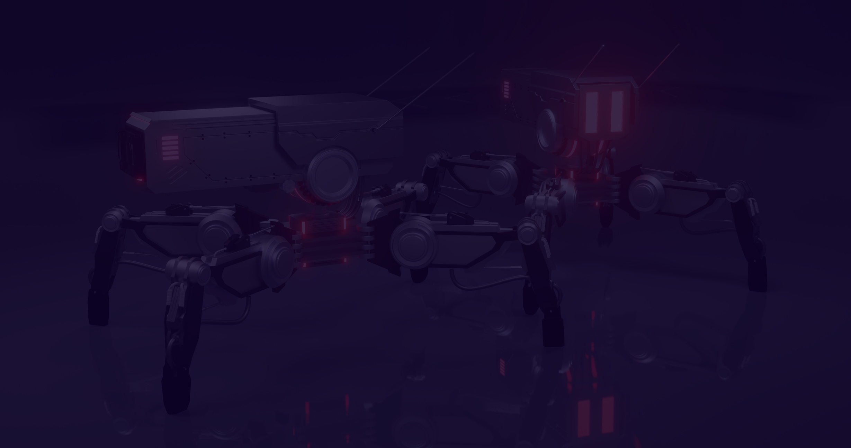

06
AI unlimited
Model Development
Paradigm Shift
GenAI represents a major change, not just a technological addition
Advanced Capabilities
Uses LLM to create and understand human-like patterns
Future of Manufacturing
Drives sophistication, sustainability, and customer focus in the industry
Conclussion
Notes:
In conclusion, GenAI, is truly changing the game in manufacturing. It's not just a new technology; it's a major shift. With the help of Large Language Models, GenAI can create and understand human-like patterns, leading to smarter and more efficient manufacturing processes. This innovation is driving the industry towards greater sophistication, sustainability, and a focus on customer needs. GenAI is shaping the future of manufacturing, making it more advanced and customer-friendly.總之，生成式人工智慧（GenAI）正在真正改變製造業的遊戲規則。這不僅僅是一項新技術；它是一項新技術。這是一個重大轉變。借助大型語言模型，GenAI 可以創建和理解類人模式，從而實現更智慧、更有效率的製造流程。這項創新正在推動產業走向更成熟、永續發展並更加關注客戶需求。 GenAI 正在塑造製造業的未來，使其更加先進、更方便客戶。
Paradigm Shift
GenAI represents a major change, not just a technological addition
Advanced Capabilities
Uses Large Language Models to create and understand human-like patterns
Future of Manufacturing
Drives sophistication, sustainability, and customer focus in the industry

Slide 27


AI unlimited
Thank You!
for listening
M11209202
M11209202 Huang Ya Pei

Slide 31
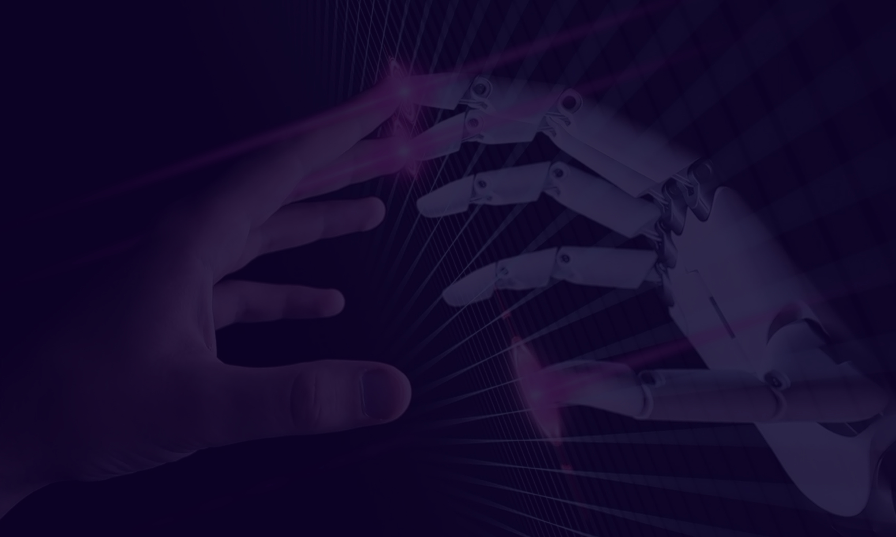
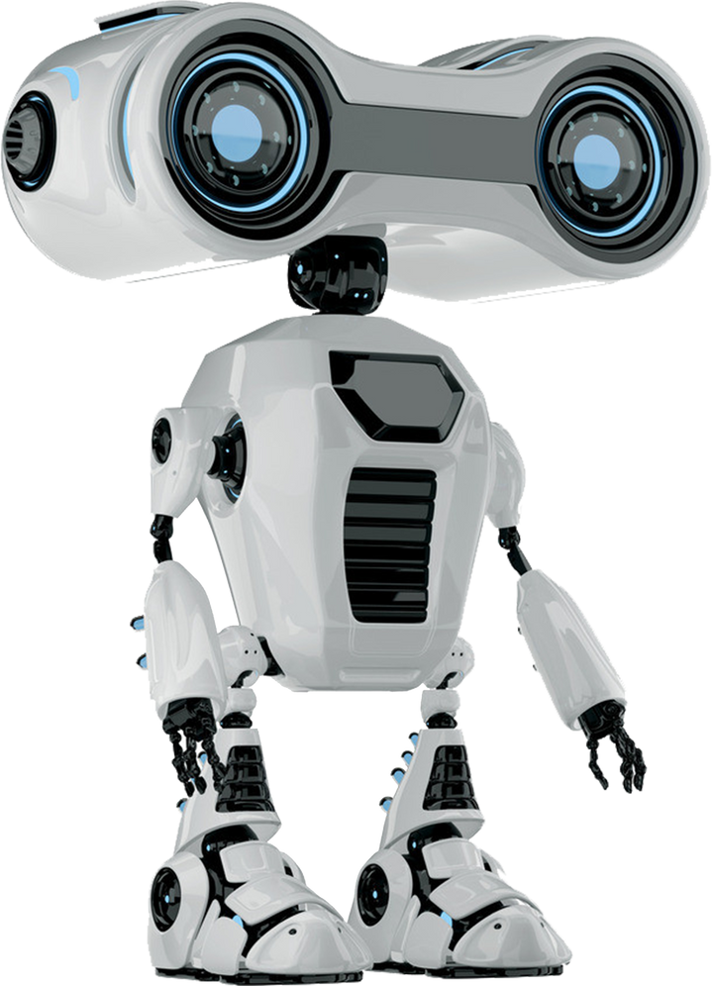
05
AI unlimited
Data Collection and Preprocessing
We gather relevant datasets from various sources and clean, normalize, and preprocess the data to ensure its quality and consistency. This step is crucial for training accurate and reliable AI models.

Slide 32



07
AI unlimited
Evaluation Metrics
We define appropriate metrics to assess the performance of our AI models, such as accuracy, precision, recall, F1 score, and area under the curve (AUC). These metrics help us quantify the effectiveness of our solutions.
www.reallygreatsite.com

Slide 33




04
AI unlimited
Methodology
Data Collection
Preprocessing
Model Selection
Gather relevant data from diverse sources.
Clean, normalize, and engineer data.
Choose and train ML/DL algorithms for peak performance.
www.reallygreatsite.com

Slide 34
07
AI unlimited
Evaluation Metrics
We define appropriate metrics to assess the performance of our AI models, such as accuracy, precision, recall, F1 score, and area under the curve (AUC). These metrics help us quantify the effectiveness of our solutions.
www.reallygreatsite.com

Slide 35

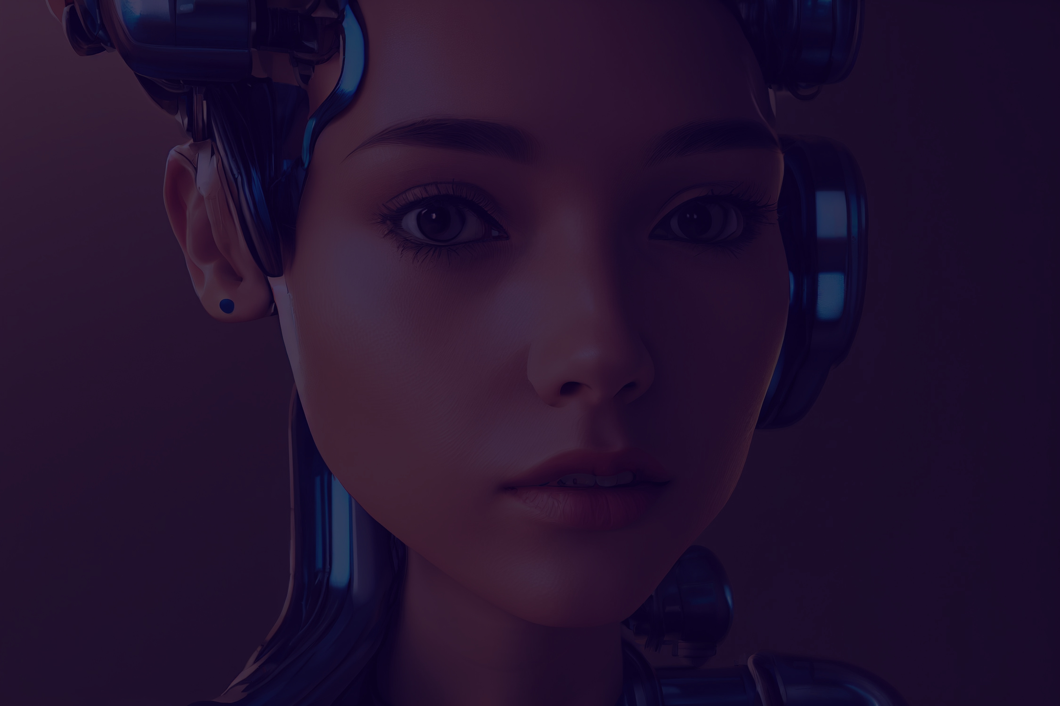
AI unlimited
Future Directions
We outline future directions for our AI project, including scalability, generalization, integration with existing systems, and exploring new applications and domains. Continuous research and development are essential for staying at the forefront of AI innovation.
www.reallygreatsite.com

